Slide 1

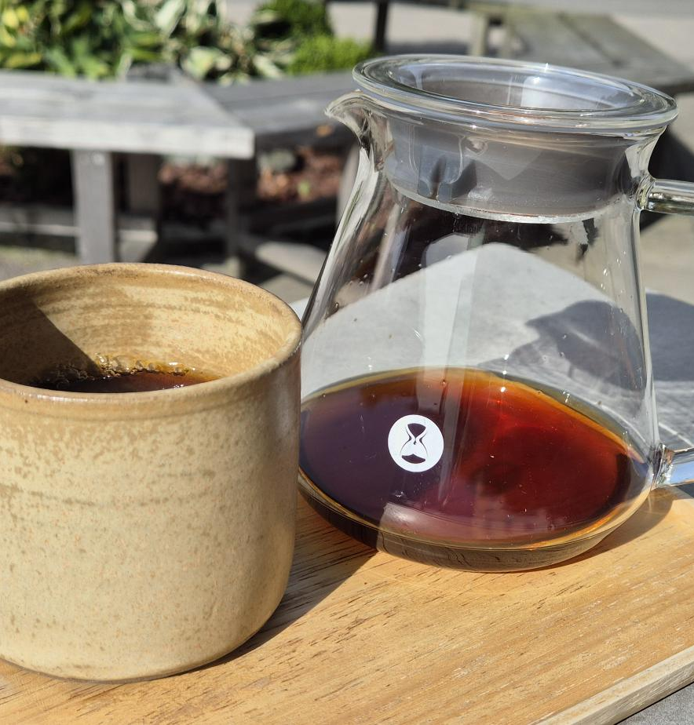



Learning How to Drink Better Coffee
Emanuel Palm Cloud Specialist, Coffee Nerd & Microsoft MVP @ Unwonted
@PalmEmanuel
Notes:
Introduction with a few comments about that it’s crazy that the organizers allowed me to do this presentation when it’s a .NET conference. But I guess that there must be someone who actually likes Java after all

Slide 2
Agenda
From Farm to Cup
Demo – prepare with a bunch of cups close to the stage
Key Takeaways – A brew recipe
Please ask questions along the way!

Slide 3
Notes
My journey in Specialty Coffee
Specialty vs Commodity coffee
SSCC 2023, presentation from x about Colombia farms having a hard time finding people because cocaine pays more.
Climate change
Commodity coffee prices, how much the farmer gets
Brew recipe

Slide 4



Emanuel Palm
💙 Everything-as-Code
📦 Makes modules & tools
📃 Fan of Open Source
☁️ Blogs at pipe.how
Fun facts!
🧗 Bouldering & Climbing
🎲 Dungeons & Dragons
🥏 Disc Golf
🇸🇪
Cloud Specialist & Coffee Nerd
@PalmEmanuel

Slide 5
Emanuel Palm
☕️ Roasts coffee at arkanum.coffee
☕️ Found specialty coffee in 2020
☕️
Fun facts!
🧗 Bouldering & Climbing
🎲 Dungeons & Dragons
🥏 Disc Golf
🇸🇪
Cloud Specialist & Coffee Nerd
@PalmEmanuel

Slide 6
Commodity vs Specialty Coffee

Slide 7
Arabica vs Robusta
Market
Varietals, development of varietals, leaf rust resilience
Caffeine comparisons? (James Hoffman video? It varies extremely widely in cafés, Robusta has more, volume vs weight in roast level (dark vs light with caffeine))

Slide 8
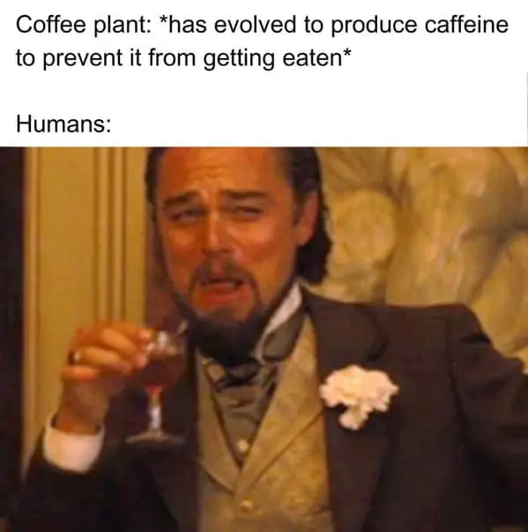
Caffeine

Slide 9
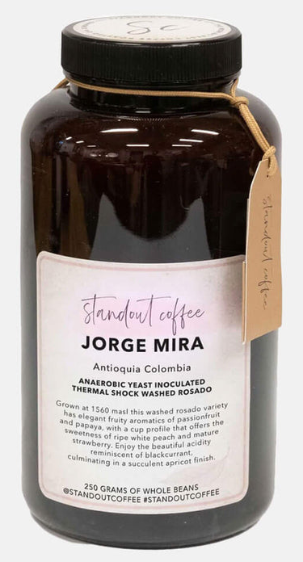
Coffee vs Wine
Flavor compounds
“Analytical chemistry studies have identified on the order of over 1,000 volatile compounds in both roasted coffee and wine. However, in both beverages only a small proportion of these compounds are present above human odor thresholds and directly contribute to perceived aroma.”
Pretentiousness - Can feel elitist but I’d like to think it often comes from a desire to accurately describe the coffee with as much traceability as possible to give justice to the farm and the process, so let’s demystify it together today

Slide 10
Farming – Planting, Harvesting
Coffee is a fruit
Coffee is hard to harvest with machines because they grow in mountainous terrain, rarely flat (some exceptions (find, Brazil??))

Slide 11
Processing

Slide 12
(The Market)

Slide 13
Roasting

Slide 14
Grinding

Slide 15
Brewing
Different brewing mechanisms and brewers, immersion, percolation, bypass
Comparison pictures of brewers
Techniques and tips, RDT

Slide 16
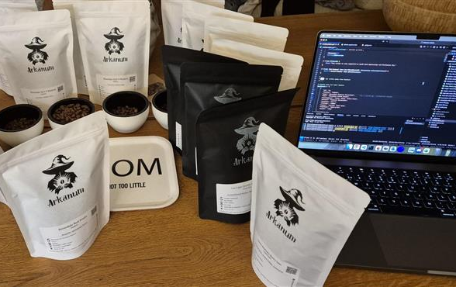
Demo Time

Slide 17
Recommendations
Don’t rely on the Azure Portal 💻
Use proper tools to alleviate complexity 🛠️
Stop making your identities overprivileged 🧐
@PalmEmanuel

Slide 18
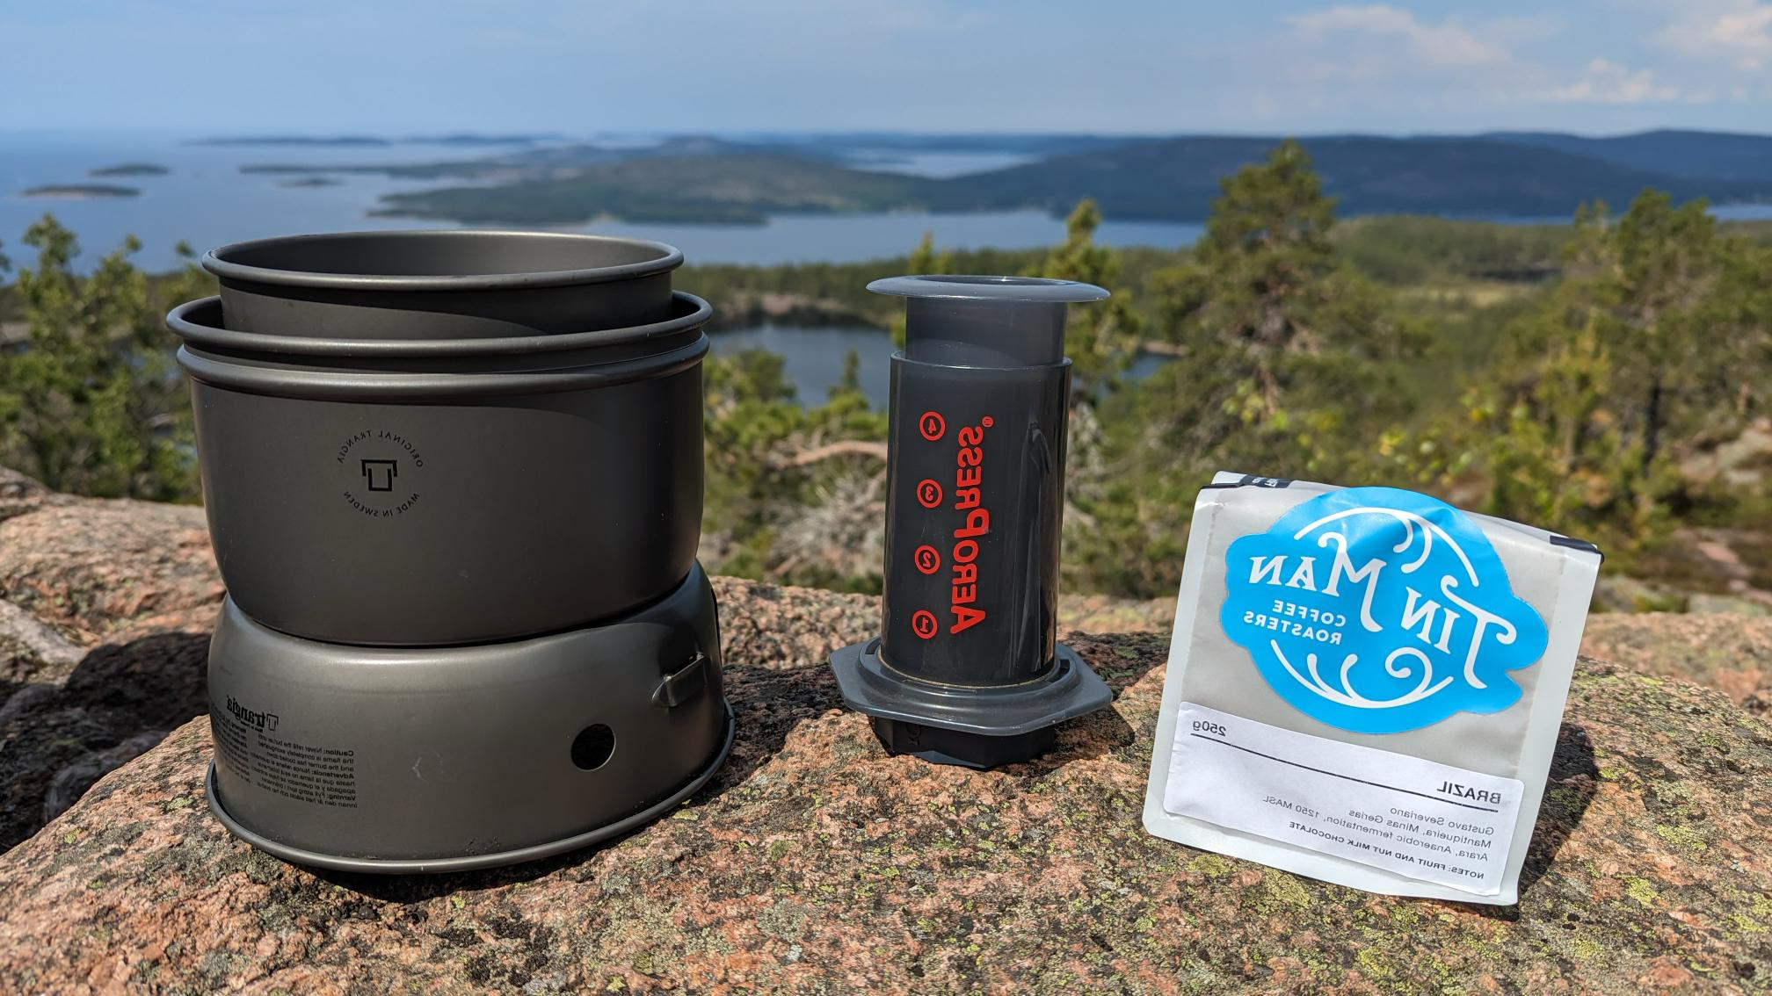
Thank you!
@PalmEmanuel

